Slide 1

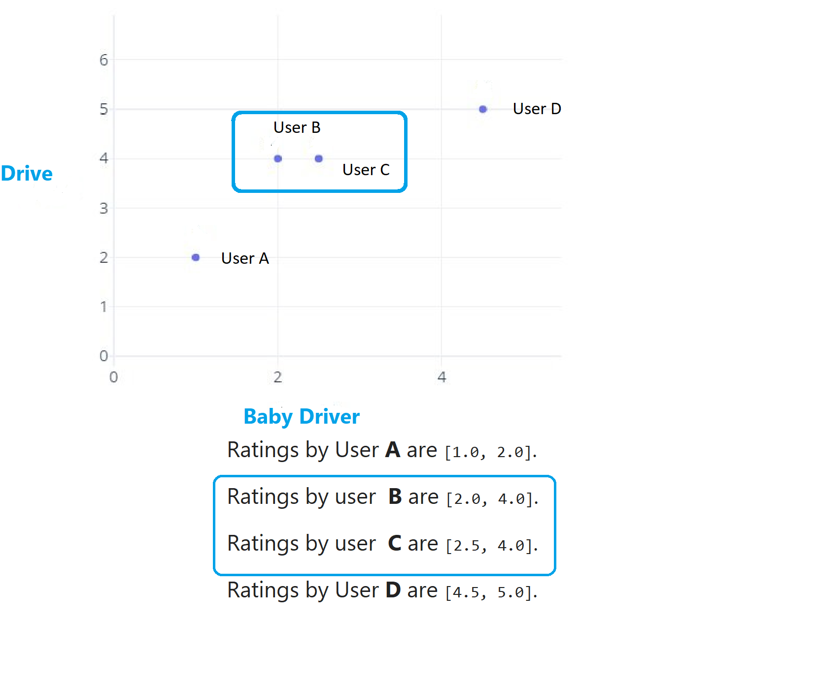
The Science Behind A Recommend
Machine learning system Using Azure ML for Everyone

Slide 2

Presenter
Alpa Buddhabhatti
Azure Consultant, Cluster Reply https://www.linkedin.com/in/alpabuddhabhatti/

Slide 3
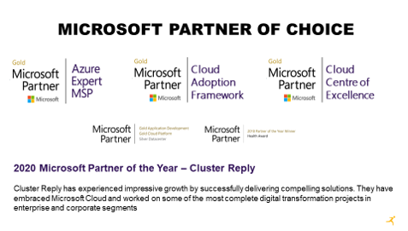
Cluster Reply

Slide 4
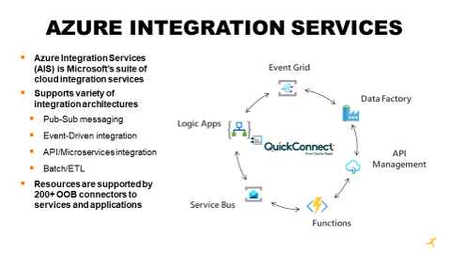
Cluster Reply

Slide 5
Agenda
Machine learning and Azure Machine learning
What is Machine learning (ML)?
What is Azure Machine learning (ML)?
Why we need Azure Machine learning (ML)?
Azure Machine learning ML Designer Tour!!!
2. Recommend Machine Learning System
What is a Recommend System.?
Type of recommendation system.
How a recommend system works?
List of Applications of Recommendation system
3.Demo: Azure ML Studio – Movie Recommendation system

Slide 6
What is Machine learning?
A Computer Program/system that can learn from
“Experience” Data or examples
It finds pattern from experience and able to make predictions about the future.
Without being explicitly programmed or told to do

Slide 7
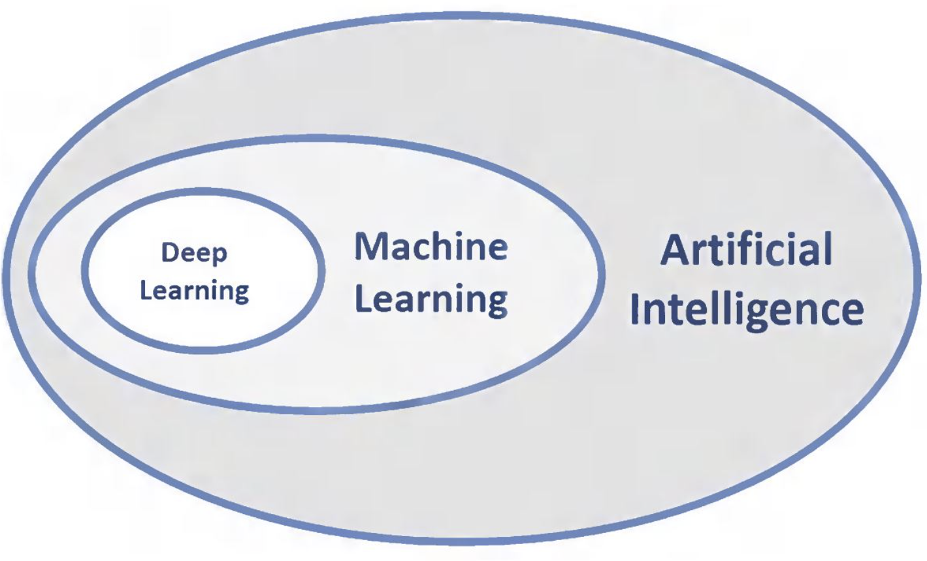
What is Machine learning Systems?
A subset of AI.
Application:
Recommender system e.g Spotify , Netflix

Slide 8
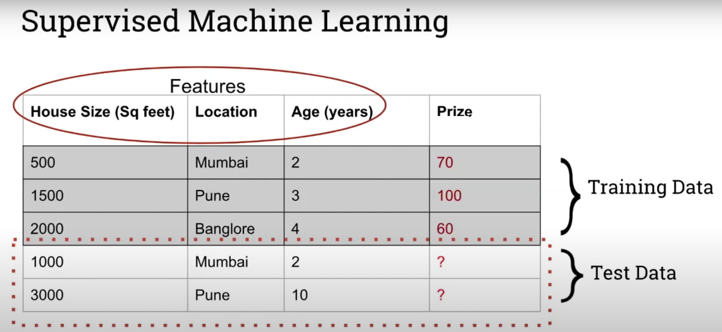
Key teams of Machine learning ?
Features
Training Data
Test Data
Target

Slide 9
What is Azure Machine learning ?
Azure Machine Learning (Azure ML) is a cloud-based service for creating and managing machine learning solutions.

Slide 10
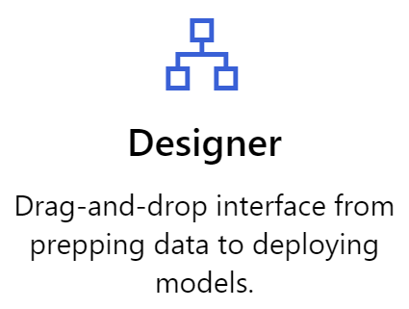
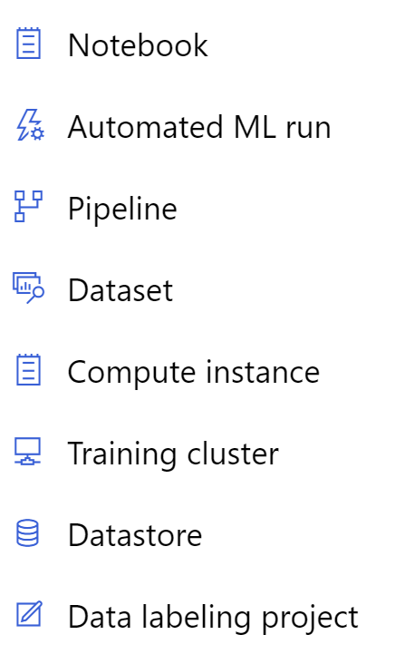
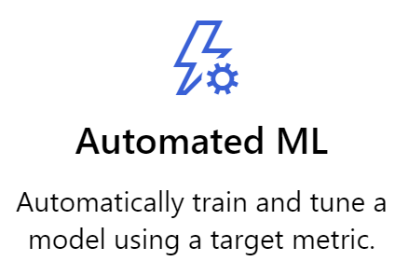
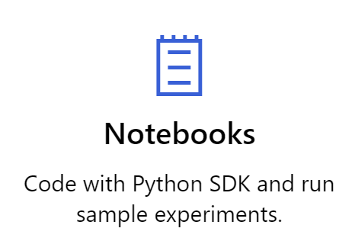
Overview of Azure Machine learning

Slide 11




Azure Machine learning process
Register Data
Train Models
Evaluate Model
Deploy Models

Slide 12



Demo - Azure Machine learning ML Designer Tour!!!
Assets
Experiments
Pipelines
Datasets
Models
Endpoints

Slide 13




Why Azure Machine Learning
In built Algorithms
Pre-built Machine learning packages
Infrastructure
Ability to scale ML solution Easily
Train time
Accelerate Model building on the fly
Deployment
Easy deployment on the fly using web services

Slide 14
Why Azure Machine Learning
Algorithms
Infrastructure
Train Time
Deployment

Slide 15
2. Recommendation systems

Slide 16
What is recommendation systems?
Type of Machine learning algorithms.
Goal to predict products which user likes /interested/buy.
Profile, search/browsing history.
To search for content that would be interesting to an individual
User Data
Rating Dataset
Recommender
Predict the Recommendation
Recommended Movies
Item Data
Movies Dataset

Slide 17
Why recommendation systems are needed?
Choices is overwhelming on internet as data grows highly.
An Information filtering systems that deal with the problem of information overload is needed.
Recommender engine is the solution to overloading information.
Beneficial to both service providers and users
Recommender systems enhance revenues
Help users to make the right choices, without spending much time

Slide 18
Why recommendation systems are needed?
Do we know which people are likely to buy a particular product ?
Which movie to suggest to people which enjoy watching ?
Which author to suggest to people which enjoy reading ?
Answer is : NO

Slide 19
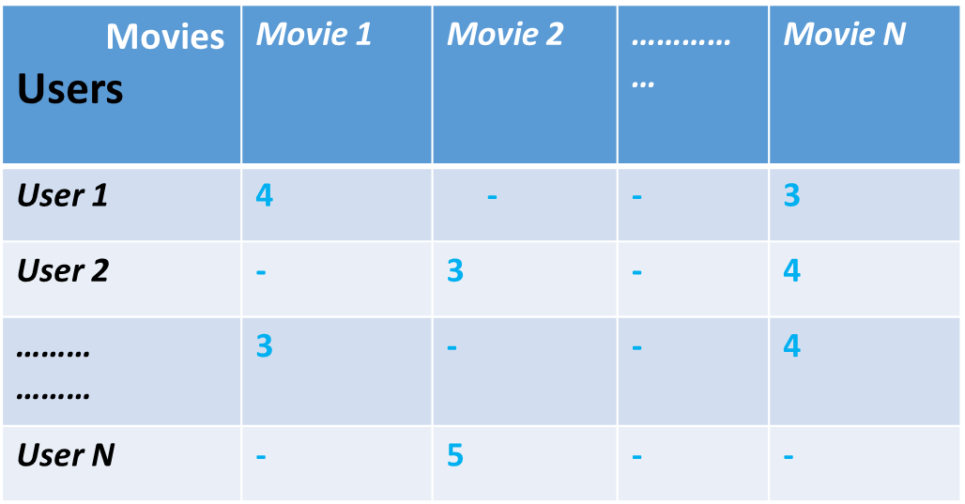
How Recommendation system works?
Users | F1 | F2 | F3
User 1 | 4 | - | 3
User 2 | - | 3 | 4
……… ……… | 3 | - | 4
User N | - | 5 | -
 | M1 | M2 | ….. …… | Mn
F1 | 4 | - |  | 3
F2 | - | 3 |  | 3
F3 | - | 5 | -
Latent Factor analysis breaks this down

Slide 20
How Recommendation system works?
P Q R
Users | F1 | F2 | F3
User 1
User 2 | - | 3
……… ………
User N
 | M1 | M2 | ….. …… | Mn
F1
F2
F3 |  |  | -
Q2
R2
p22=q2.r2

Slide 21
Various approaches/Types
There are various types of recommended system available.
Popularity-Based (Generalized )
Content-based filtering (Personalized)
Collaborative filtering (Personalized)
Hybrid filtering (Personalized)

Slide 22


Popularity Based Filtering
Works on the principle of popularity and or anything which is in trend right now.
Most simple algorithms.
Examples:
News filtered by trending and most popular news.
Trending videos.

Slide 23

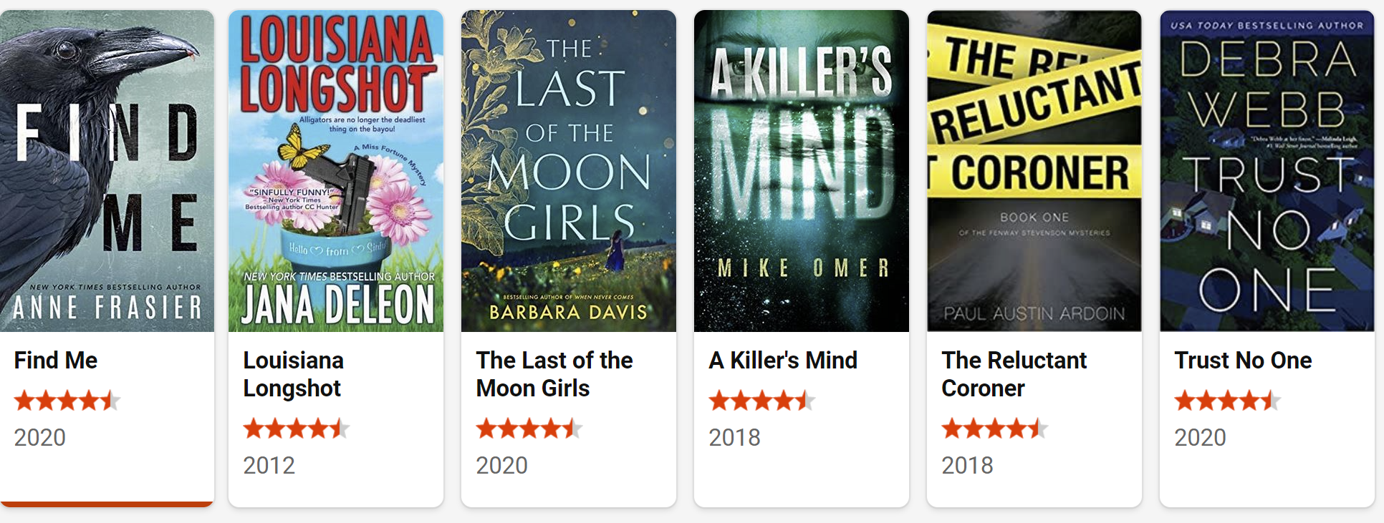
Popularity-Based Recommendation System

Slide 24
Popularity-Based Recommendation System
Provide a general chart of recommended movies to all the users.
This is not use for personalized recommendations.

Slide 25
Content-based filtering
Content-based techniques finds the similarity between content and recommends items.
The content of the movie (overview, cast, crew, keyword, tagline etc) is used to find its similarity with other movies.
Then the movies that are most likely to be similar are recommended.

Slide 26

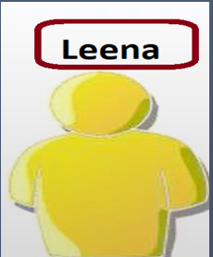
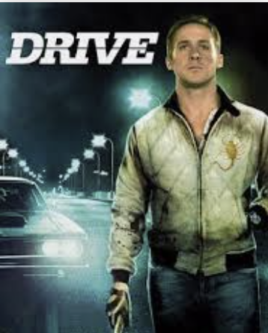
Content-based filtering
Likes
Similar Movie
Recommended Movie

Slide 27




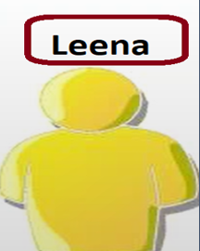


Content-based filtering
(Adventure ,Super hero)
(Comedy, Adventure, Super hero, Scifi)
Batman vs Superman
(Comedy ,Super hero)
2
Guardian of Galaxy
(Comedy, Adventure, Scifi)
10
Captain Amerika: Civil War
8
(Super hero)
9
Hitchiker’s guide to Galaxy
?
2
Batman Begin
(Comedy ,Super hero)
?
?
8
Spider Man

Slide 28
Content-based filtering – problems
It depends only on the user previous choices, making this method robust to avoid the cold-start problem

Slide 29


Collaborative filtering
Most mature and the most commonly implemented
Recommends items by identifying other users with similar taste.
Examples

Slide 30
Collaborative filtering
If two users have the same opinion about a bunch of products.
They have likely to have same opinion about other products too!

Slide 31
Collaborative filtering
If you like this , you will love this!!
User Purchases
User Browsing history
User Clicks
User Ratings ,Reviews
Collaborative filtering
If you have bought this you will need this!!

Slide 32
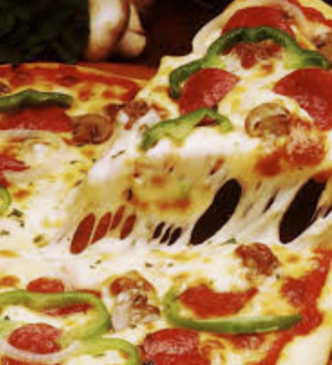

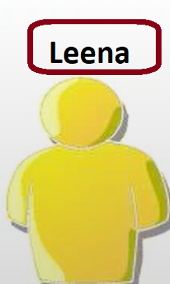
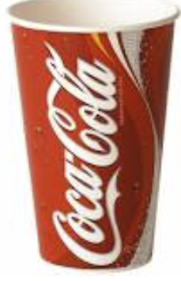

Collaborative filtering- Example
Similar
Buy
Buy
Recommend
Buy

Slide 33
Collaborative filtering
User-to-User Collaborative filtering
Objectives: Recommend a Movie for Ben
 | Leena | Raj | BEN
Movie 1 | 4 | 2 | 5
Movie 2 | 5 | 4 | ??
Movie 3 | 1 | 2 | 1
Movie 4 | 3 | 1 | 3
Movie 5 | 5 | 4 | ??
Find similar users to Ben and recommend movies which they have liked and Ben have not watched yet

Slide 34
Steps Involved in Collaborative Filtering
The first step is to find similar users or items.
The second step is to predict the ratings of the items that are not yet rated by a user.
So, you will need the answers to these questions:
How do you determine which users or items are similar to one another?
Given that you know which users are similar, how do you determine the rating that a user would give to an item based on the ratings of similar users?
How do you measure the accuracy of the ratings you calculate?

Slide 35
Collaborative filtering
Item-to-Item Collaborative filtering
Objectives: Recommend a Movie to Ben
 | Movie 1 | Movie 2 | Movie 3 | Movie 4 | Movie 5
Leena | 4 | 3 | 1 | 3 | 5
Raj | 2 | 4 | 2 | 1 | 4
Ben | 5 | ?? | 1 | 3 | ??
Find similar Movies based on rating given by other users

Slide 36
Collaborative filtering -Quiz
Quiz
Given set of ratings from past, Recommend a movie for user Ben
 | Leena | Raj | Ben
Movie 1 | 4 | 2 | 2
Movie 2 | 5 | 4 | 3
Movie 3 | 1 | 2 | 2
Movie 4 | 3 | 1 | 2
Movie 5 | 3 | 4
Movie 6 | 5 | 3

Slide 37
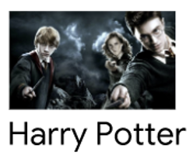

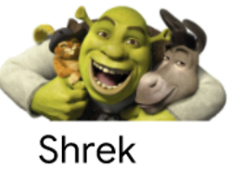






Collaborative filtering -Quiz
Movies Users
 | 4 |  | 3 | 4
 |  | 3 |  |  | 4
 | 3 | 4 | 3 | ????
 |  |  |  | 5 | 4

Slide 38
Hybrid filtering
Combines two or more filtering techniques

Slide 39
How Recommendation system works?
To Identify Factors, Training data represented as Matrix
Movies Users | Movie 1 | Movie 2 | …………… | Movie N
User 1 | 4 | - | - | 3
User 2 | - | 3 | - | 4
……… ……… | 3 | - | - | 4
User N | - | 5 | - | -
User Id
Item Id
Rating

Slide 40
How Recommendation system works?
Distance between two movies
A Recommended system uses
Mathematical technique to calculate similarity.
Most common techniques are:
Euclidean similarity
Hamming similarity
Cosine similarity
Pearson correlation

Slide 41
Quick quiz
Who are the users and items in Recommender systems for following platforms?
Facebook
LinkedIn
Amazon
Netflix
YouTube

Slide 42
Quick quiz
Who are the users and items in Recommender systems for following platforms?
Facebook (users : members , Items :members)
LinkedIn (users : members , Items :jobs /posts/Members )
Amazon (users : members , Items :products like books ,electronics items)
Netflix (users: members , Items :Movies/TV programs)
YouTube (users: members , Items : Videos)

Slide 43
Applications /Use Cases
Books
Music Tracks
News Articles
Restaurants
Future Friends (Social Network Sites)
Courses in e-learning
Jobs
Research Papers
Investment Choices
TV Programs
Clothes
Online Mates (Dating Services)
Supermarket Goods

Slide 44
3. DEMO

Slide 45
DEMO
Scenario :
Using given dataset Movie rating and IMDB Movie title , recommend a Movie to user based on similar Movie user has rated or liked.
Algorithm -Single Value Decomposition (SVD)
Predict ratings for a given user and item(Predict Rating for given user and Movie)
Recommend items to a user (Recommend Movies )
- Using Azure Machine Learning designer

Slide 46
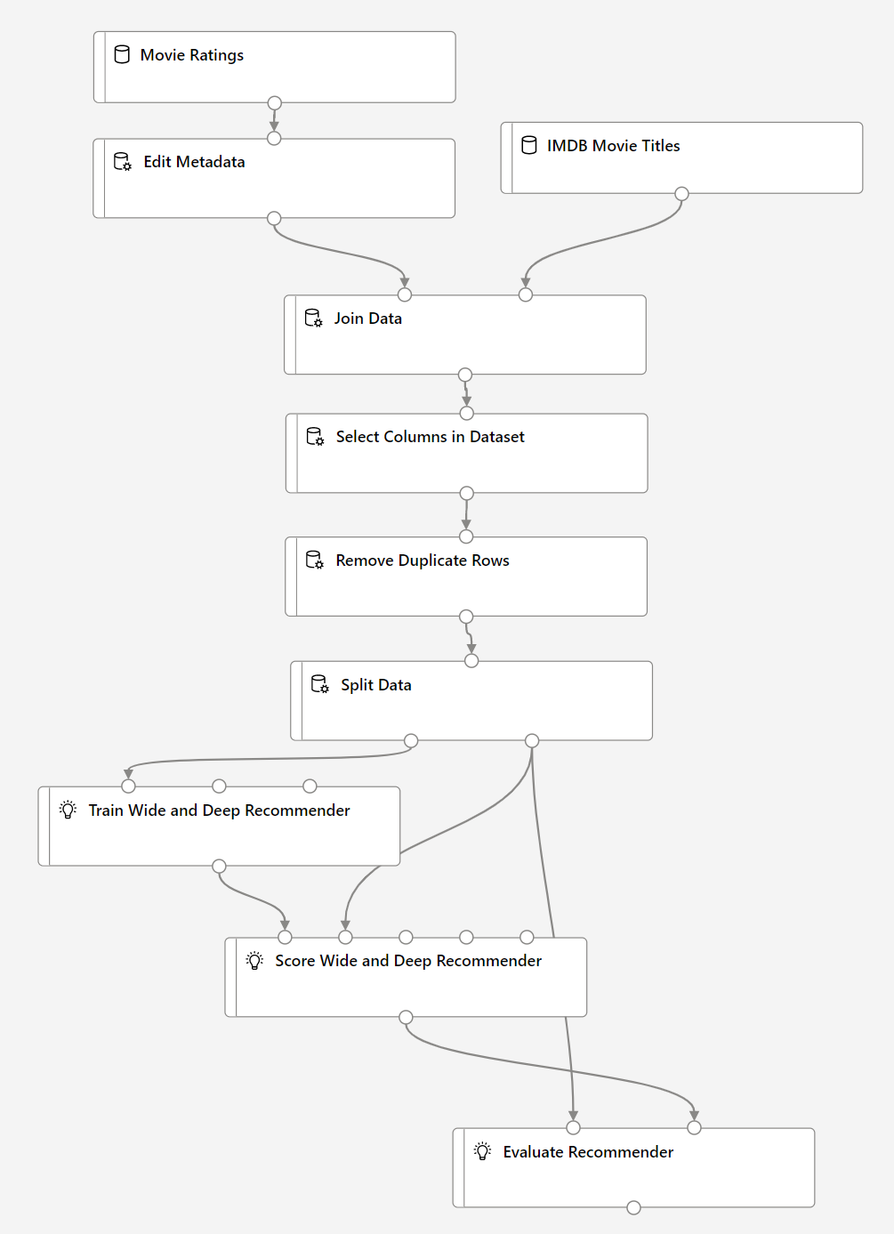
DEMO
Datasets
Movie Rating
IMDB Movie title
Join Two datasets
Selecting required columns or Python script
Removing duplicate rows
Split datasets
Using SVD OR TWAD recommender Model
Scoring Model
Evaluating Model
Deploy model
Consume Model

Slide 47
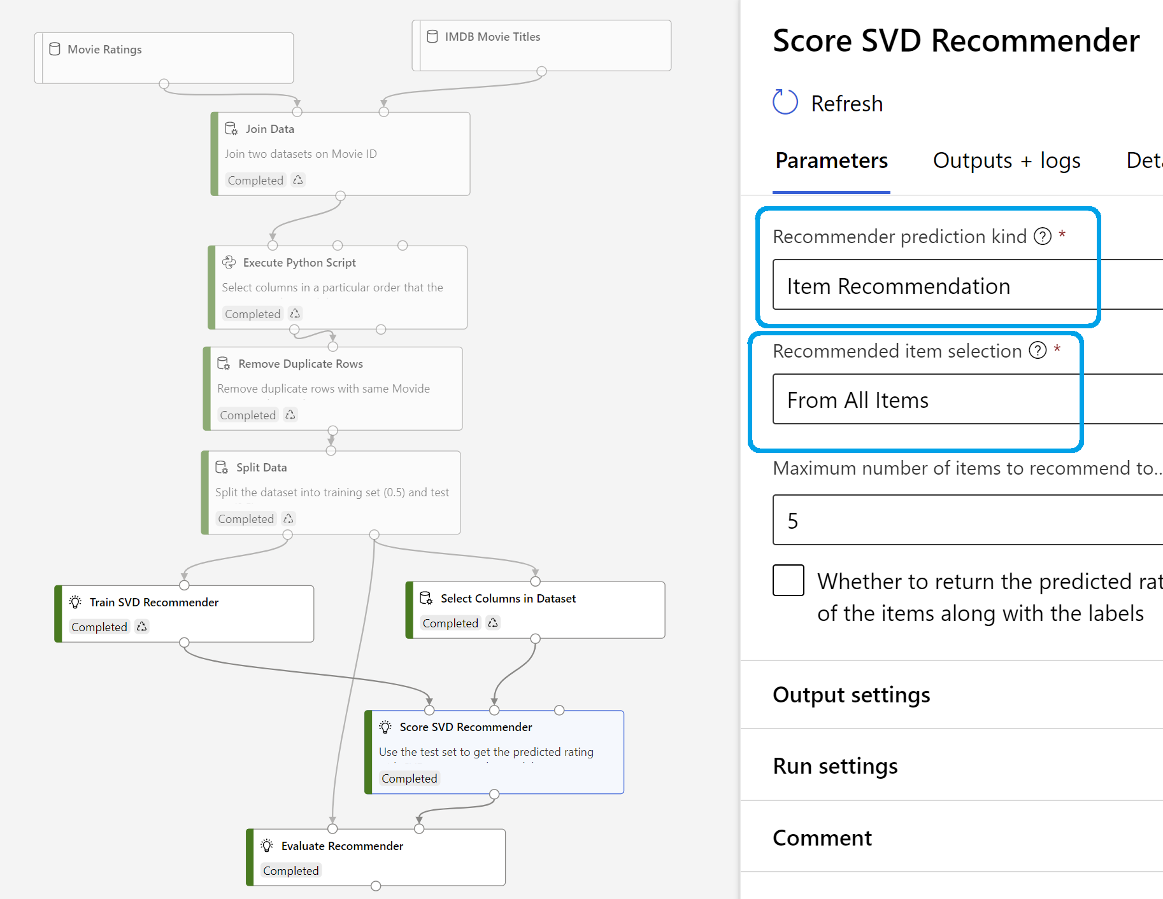
DEMO – Score SVD Recommender pipeline execution

Slide 48
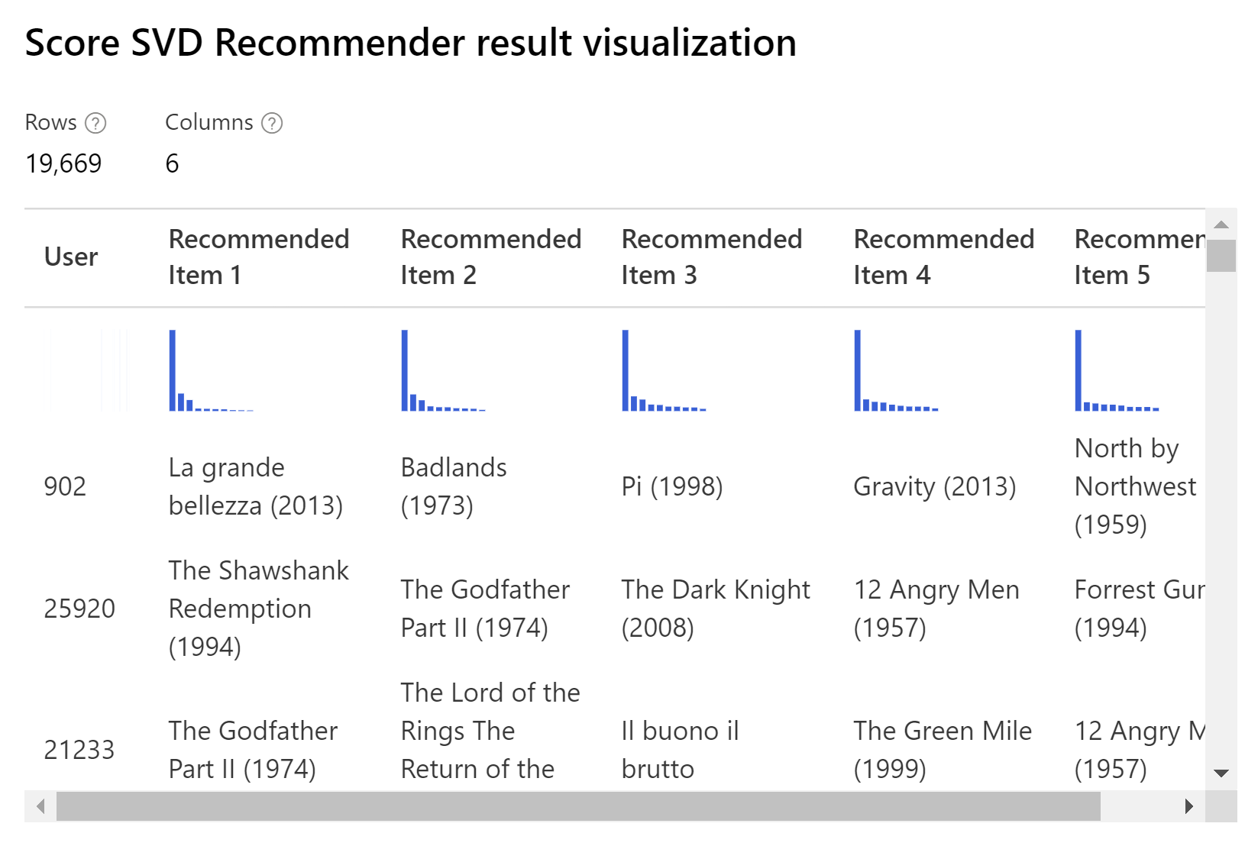
DEMO – Score SVD Recommender result

Slide 49
Thank you!!!
Any Questions.???
Alpa Buddhabhatti
Azure Consultant, Cluster Reply
https://www.linkedin.com/in/alpabuddhabhatti/

Slide 50
Resources & useful links
https://www.analyticssteps.com/blogs/what-are-recommendation-systems-machine-learning
Https://www.Mygreatlearning.Com/blog/masterclass-on-movie-recommendation-system/
Https://towardsdatascience.Com/a-simple-movie-recommendation-system-d135cfd0a22d
Https://medium.Com/better-programming/building-a-movie-recommendation-engine-for-beginners-7161430e35b9
Https://medium.Com/nerd-for-tech/simple-movie-recommendation-system-using-python-e5df3ce58664
Https://docs.Microsoft.Com/en-us/azure/architecture/example-scenario/ai/movie-recommendations
Https://docs.Microsoft.Com/en-us/dotnet/machine-learning/tutorials/movie-recommendation
Https://developers.Google.Com/machine-learning/recommendation/collaborative/basics
https://towardsdatascience.com/the-remarkable-world-of-recommender-systems-bff4b9cbe6a7
https://medium.com/the-owl/recommender-systems-f62ad843f70c

